Slide 1
Constraint Satisfaction Problems

Slide 2
Outline
Introduction
Defining Constraint Satisfaction Problems
Real-World Examples of CSPs
Backtracking Search
Improving Backtracking Search
CSP Examples
Conclusion

Slide 3
Introduction
The search algorithms we discussed so far had no knowledge of the state representation (black box with no internal structure).
  For each problem we had to design a new state representation.
In Constraint Satisfaction Problem (CSP) we use an internal representation for each state: a set of variables represent these states, each of which has a value.
We can build specialized search algorithms that operate efficiently on this general state representation.

Slide 4
Defining Constraint Satisfaction Problems
A Constraint Satisfaction Problem (CSP) consists of three components:
  A set of variables that can take a finite value; 𝑉={𝑉₁, 𝑉₂, 𝑉₃,…, 𝑉_{n}}
  A set of domains, one for each variable from which a value is picked 𝐷={D_{v1}, D_{v2}, D_{v3},…, D_{vn}}.
  A set of constraints 𝐶={C₁, C₂, C₃,…, C_{m}} that specify allowable combination of values
A solution to a CSP is an assignment of values to all variables such that all constraints are satisfied.

Slide 5
Defining Constraint Satisfaction Problems
Each variable in the variable set can belong to different domains.
The elements in the domain can be both continuous and discrete.
All sets should be finite except for the domain set.
Each constraint 𝐶:
  Has a set of variables it is over, called scope of the constraint
    e.g., the constraint V₂ ≠ 2 has a scope {V₂}; while V₁ ≥ V₂ has scope {V₁, V₂}
  Has a restriction on the values of the variables in the scope
    e.g., the constraint V₂ ≠ 2 and V₁ ≥ V₂ is restricting the values of V₁ and V₂
  Is a Boolean function that maps assignments to the variables in its scope to true/false.
    e.g., 𝐶(𝑉₁ =𝑎, 𝑉₂ =𝑏, 𝑉₃ =𝑐) = 𝑇𝑟𝑢𝑒

Slide 6
Defining Constraint Satisfaction Problems
Unary Constraints (over single variable)
  e.g. C₁(X): X=2; C₂(Y): Y>5
Binary Constraints (over two variables)
  e.g. C₃(X,Y): X+Y<6
Higher-order constraints (over 3 or more variables)
  We can convert any constraint into a set of binary constraints (may need some auxiliary variables).
Can be represented by Constraint Graph that represents the relationship between the variables
  Nodes are variables, edges show constraints.

Slide 7
Real-World Examples of CSPs
Assignment problems: e.g., who teaches what class
Timetabling problems: e.g., which class is offered when and where?
Transportation scheduling
Factory scheduling
Fault diagnosis
… and many more

Slide 8
CSPs as Search Problems
CSPs are a special subset of search problems in which:
  States: assignments of values to a subset of the variables
  Initial state: the empty assignment (no variables assigned values)
  Goal state: complete assignment of values to all variables that satisfies all the constraints.
  Actions: Assign a value to an unassigned variable.
  Solution: The solution of a CSP is an assignment of a value to each variable such that all constraints are satisfied.
    Unlike previous search problems, knowing the path from the initial state to the goal state is not important.

Slide 9
Backtracking Search
Backtracking search with single-variable assignments for a CSP is the basic uninformed search for solving CSPs
Backtracking search is a Depth-First Search (DFS) with two improvements:
  Consider assignments to a single variable at each step
  Check constraints as you go
    consider only new assignments which do not conflict previous assignments
Backtracking search incrementally builds candidates to the solutions and abandons a candidate ("backtracks") as soon as it determines that the candidate cannot possibly be completed to a valid solution.

Slide 10
Backtracking Search algorithm
Algorithm: Backtracking-Search(assignment)
1: if assignment is complete then
2: return assignment
3: V = Select the next unassigned-variable(variables)
4: for each value in Domain(V) do
5: if {V = value} is consistent with all constraints then
6: add {V = value} to assignment
7: result = Backtracking-Search(assignment)
8: if result ≠ failure then
9: return result
10: remove {V = value} from assignment
11: end for
12: return failure

Slide 11
Solving CSPs using Backtracking Search
To solve a CSP, we require the following steps:
  Step 1: Create a variable set.
  Step 2: Create a domain set.
  Step 3: Create a constraint set with variables and domains (if possible) after considering the constraints.
  Step 4: Set the order of variable and domain sets.
  Step 5: Set the initial state with empty assignments for all variables.
  Step 6: Use backtracking search to assign values to all variables. A solution is found if variables assignments satisfy all constraints.

Slide 12
CSP Example 1
Example 1:
  Suppose you have a set of variables 𝑉1, 𝑉2, 𝑉3. Each variable in the set 𝑉, has a non-empty domain of possible values, particularly D_{𝑉1} = {1,2,3}, D_{𝑉2} = {1,2}, and D_{𝑉3} = {2,3}. A set of constraints 𝐶 = {𝑉1>𝑉2, 𝑉2≠𝑉3, 𝑉1≠𝑉3}. Find the values that satisfy the constraints.
Solution:
  The goal is to assign a value to each variable such that none of the constraints are violated.
  We will use backtracking search to solve the problem.

Slide 13
CSP Example 1 - Solution
Step 1: We need to create the variable set, from the problem
  𝑉={𝑉1,𝑉2,𝑉3} is the variable set.
Step 2: We need to define the domain set; the domain is as follows:
  D_{𝑉1} = {1,2,3}
  D_{𝑉2} = {1,2}
  D_{𝑉3} = {2,3}
Step 3: Constraints are:
  𝐶1 = 𝑉1 > 𝑉2
  𝐶2 = 𝑉2 ≠ 𝑉3
  𝐶3 = 𝑉1 ≠ 𝑉3

Slide 14
CSP Example 1 - Solution
Step 4: The order of selecting variables and values:
  The same order they appear in the variables and domain sets.
Step 5: Set the initial assignment of variables:
  𝑉1 = {}, 𝑉2 = {}, 𝑉3 = {}.
Step 6: Use backtracking search to find the solution by going over all possible values (one at a time) and make sure that all constraints are satisfied. If you reach an assignment of values that breaks the constraints, backtrack to the last decision made and change the value.
  Detailed steps are given in next slides.

Slide 15
CSP Example 1 - Solution
    Backtracking search steps:
    Start with 𝑉1=1 (the first value in its domain). Since no values are assigned to 𝑉2 and 𝑉3, no constraints are dissatisfied → move to the next assignment.
    Assign 𝑉2=1 (the first value in its domain). Check if 𝐶1=𝑉1>𝑉2 is satisfied. Since 1>1 is not satisfied, then the pair of values 𝑉1=1,𝑉2=1 is not a possible assignment ➔ backtrack.
  Domain:
  𝑉1 = {1,2,3}
  𝑉2 = {1,2}
  𝑉3 = {2,3}
  Constraints:
  𝐶1 = 𝑉1>𝑉2
  𝐶2 = 𝑉2≠𝑉3
  𝐶3 = 𝑉1≠𝑉3

Slide 16
CSP Example 1 - Solution
Backtrack:
    Change the value of 𝑉2 by selecting the next possible value in the domain of 𝑉2, i.e. set 𝑉2=2 .
    However, 𝐶1 is not satisfied again, so I stop and backtrack.
    Since we have exhausted the domain of 𝑉2, backtrack and change the value of 𝑉1, i.e., set 𝑉1=2 then move over to 𝑉2 and assign 𝑉2=1.
    Now constraint 𝐶1=𝑉1>𝑉2 is satisfied (i.e., 2>1).
    Since no value is assigned for 𝑉3 (i.e., condition cannot be checked), no constraints are dissatisfied.
  Domain:
  𝑉1 = {1,2,3}
  𝑉2 = {1,2}
  𝑉3 = {2,3}
  Constraints:
  𝐶1 = 𝑉1>𝑉2
  𝐶2 = 𝑉2≠𝑉3
  𝐶3 = 𝑉1≠𝑉3

Slide 17
CSP Example 1 - Solution
Assign 𝑉3=2 (the first value in its domain), so we get the tuple {𝑉1=2,𝑉2=1,𝑉3=2}.
  Check the constraints
    𝐶1 is satisfied,
    𝐶2 is satisfied,
    𝐶3 is not satisfied due to C(𝑉1≠𝑉3), so we backtrack.
Assign 𝑉3=3 (the next value in the domain) so we get the tuple {𝑉1=2,𝑉2=1,𝑉3=3}.
  𝐶1, 𝐶2 and 𝐶3 are all satisfied.
Since we have satisfied all constrains 𝐶={𝐶1,𝐶2,𝐶3} we stop as we found a solution to the CSP.
  Domain:
  𝑉1 = {1,2,3}
  𝑉2 = {1,2}
  𝑉3 = {2,3}
  Constraints:
  𝐶1 = 𝑉1>𝑉2
  𝐶2 = 𝑉2≠𝑉3
  𝐶3 = 𝑉1≠𝑉3

Slide 18
CSP Examples 1: Solution’s search tree
{ }
  Domain:
  𝑉1 = {1,2,3}
  𝑉2 = {1,2}
  𝑉3 = {2,3}
  Constraints:
  𝐶1 = 𝑉1>𝑉2
  𝐶2 = 𝑉2≠𝑉3
  𝐶3 = 𝑉1≠𝑉3
V1=1
V1=2
V1=3
V2=1
V2=2
V2=1
V2=2
V2=1
V2=2
✗
✗
✗
V3=2
V3=3
V3=2
V3=3
V3=2
V3=3
✗
✓
✓
✗
✗
✗
The search tree shows that two solutions to this CSP are possible depending on the order of selecting variables

Slide 19

Map Coloring
The map-coloring CSP requires that you assign a color to each region of a map such that any two regions sharing a border have different colors.
The constraints for the map-coloring problem are :
  Each region is assigned one color only, of $C$ possible colors.
  The color assigned to one region cannot be assigned to adjacent regions.

Slide 20
CSP Example 2: Map Coloring
Given four colors, Red, Green, Yellow , Blue denoted by R, G, Y, B,
A computer program must Color the regions Tabuk, Hail, Madina, Al-Qasim, Makkah and Riyadh such that no adjacent regions have the same color.

Slide 21
CSP Example 2: Map Coloring
Convert the problem to CSP
  Variables:
    Regions V={V1,V2,V3,V4,V5,V6}
  Domains and order:
    Colors allowed
  Constraints:
  No two regions sharing a boundary have the same color
V1 = Tabuk | V2 = Ha’il | V3 = Qassim
V4 = Riyadh | V5 = Makkah | V6 = Medina
D1= {R, G , Y , B} | D2= {R, G , Y , B} | D3= {B, G, Y, R}
D4= {R, G , Y , B} | D5= {Y , G, R, B} | D6= {R, G , Y , B}

Slide 22
CSP Examples 2: Map-coloring – Backtracking
Convert the map into a graph:
V1 = Tabuk | V2 = Ha’il | V3 = Qassim
V4 = Riyadh | V5 = Makkah | V6 = Medina
Step 0
V1!=V2
V2!=V6
V4!=V5
V1!=V6
V3!=V4
V4!=V6
V2!=V3
V3!=V6
V5!=V6
A constraint is represented as an edge connecting two nodes in a graph

Slide 23
CSP Examples 2: Map-coloring – Backtracking
Step 1: Select next unassigned variable in order from the variable set V={V1, V2, V3, V4, V5, V6}
    V1 = Tabuk
Step 2: Color the selected variable (region) with the first value in the domain; R.
Step 3: Check all constraints
  All constraints are OK.
V1 = Tabuk | V2 = Ha’il | V3 = Qassim
V4 = Riyadh | V5 = Makkah | V6 = Medina
Step 1

Slide 24
CSP Examples 2: Map-coloring – Backtracking
Step 4: Select next unassigned variable in order
    V2 = Ha’il
Step 5: Color the selected variable (region) with the first value in the domain; R.
Step 6: Check constraints:
  V1 = R and V2= R, constraint is not met ➔ backtrack
  Assign next color in the domain G
  all constraints are met.
V1 = Tabuk | V2 = Ha’il | V3 = Qassim
V4 = Riyadh | V5 = Makkah | V6 = Medina
Step 2

Slide 25
CSP Examples 2: Map-coloring – Backtracking
Step 7: Select next unassigned variable in order
  V3 = Qassim
Step 8: Color the selected variable (region) with the first value in the domain; B.
Step 9: Check constraints:
  All constraints are OK.
V1 = Tabuk | V2 = Ha’il | V3 = Qassim
V4 = Riyadh | V5 = Makkah | V6 = Medina
Step 3

Slide 26
CSP Examples 2: Map-coloring – Backtracking
Step 10: Select next unassigned variable in order
  V4 = Riyadh
Step 11: Color the selected variable (region) with the first value in the domain; R.
Step 12: Check constraints:
  All constraints are OK.
V1 = Tabuk | V2 = Ha’il | V3 = Qassim
V4 = Riyadh | V5 = Makkah | V6 = Medina
Step 4

Slide 27
CSP Examples 2: Map-coloring – Backtracking
Step 13: Select next unassigned variable in order
    V5 = Makkah
Step 14: Color the selected variable (region) with the first value in the domain; Y.
Step 15: Check constraints:
  All constraints are OK.
V1 = Tabuk | V2 = Ha’il | V3 = Qassim
V4 = Riyadh | V5 = Makkah | V6 = Medina
Step 5

Slide 28
CSP Examples 2: Map-coloring – Backtracking
Step 16: Select next unassigned variable in order
  V6 = Madina
Step 17: Color the selected variable (region) with the first value in the domain; R.
Step 18: Check constraints:
  V6 = R constraint is not met ➔ backtrack
  V6 = G constraint is not met ➔ backtrack
  V6 = Y constraint is not met ➔ backtrack
  V6 = B constraint is not met ➔ backtrack
  V5 = G all constraints are met
Step 6

Slide 29
CSP Examples 2: Map-coloring – Backtracking
Step 19: Color V6:
  V6 = R constraint is not met ➔ backtrack
  V6 = G constraint is not met ➔ backtrack
  V6 = Y constraint is met
Step 20: All variables are assigned ➔ End
V1 = Tabuk | V2 = Ha’il | V3 = Qassim
V4 = Riyadh | V5 = Makkah | V6 = Medina
Step 7

Slide 30
CSP Example 2: Backtracking Algorithm Summary
Step 0
Step 1
Step 2
Select first color in Domain, V1 = R
Backtrack V2 once to Select V2 = G
Note: Backtracking steps are not shown and are embedded into each step

Slide 31
CSP Example 2: Backtracking Algorithm Summary
Step 3
Step 4
Step 5
Select first color in Domain, V3 = B
Select first color in Domain, V4 = R
Select first color in Domain, V5 = Y
Note: Backtracking steps are not shown and are embedded into each step

Slide 32
CSP Example 2: Backtracking Algorithm Summary
Step 6
Step 7
Backtrack 4 times for V6 then backtrack once for V5 and select V5 = G
Backtrack 2 times for V6 and select V6 = Y
Note: Backtracking steps are not shown and are embedded into each step

Slide 33
Problems with Backtracking Search
Keeps repeating the same failed variable assignments
Does not detect inevitable failures earlier in the search
May explore areas of the search space that aren’t likely to succeed

Slide 34
Improving Backtracking Search
General-purpose ideas give huge gains in speed
Forward Checking: Can we detect an inevitable failure early?
Ordering:
  Which variable should be assigned next?
  In what order should its values be tried?
Consistency: Prune the domains as much as possible before selecting values for variables.

Slide 35
Backtracking - Forward Checking
Forward checking propagates information from assigned to unassigned variables and crosses off values that violate a constraint when added to the existing assignment
    In the map coloring example, the domain of each adjacent region that was not colored will lose the ability of choosing the same color to keep up with the constraint. For example, once Tabuk is assigned R both Ha’il and Madina will loose that color from their domains.
V1 = Tabuk | V2 = Ha’il | V3 = Qassim
V4 = Riyadh | V5 = Makkah | V6 = Medina

Slide 36
CSP Example 2: Map Coloring - Forward Checking
Step 1:
  Select the first variable from the variable set, V1 = Tabuk, and assign it the first value in its domain; R.
  Cross off the value (color) R from domains of all adjacent regions, i.e., V2 = Ha’il and V6 = Medina
Step 0
Step 1
Select first color in Domain, V1 = R
Note the domain reduction of V2 and V6
V1 = Tabuk | V2 = Ha’il | V3 = Qassim
V4 = Riyadh | V5 = Makkah | V6 = Medina
D1= {R, G , Y , B} | D2= {R, G , Y , B} | D3= {B, G, Y, R}
D4= {R, G , Y , B} | D5= {Y , G, R, B} | D6= {R, G , Y , B}

Slide 37
CSP Example 2: Map Coloring - Forward Checking
Step 2:
  Select the next unassigned variable from the variable set, V2 = Ha’il, and assign it the next available value in its domain; G.
  Cross off the value (color) G from domains of all adjacent regions, i.e., V3 and V6
Step 2
V1 = Tabuk | V2 = Ha’il | V3 = Qassim
V4 = Riyadh | V5 = Makkah | V6 = Medina
Note the domain reduction of V3 and V6

Slide 38
CSP Example 2: Map Coloring - Forward Checking
Step 3:
  Select the next unassigned variable from the variable set, V3 = Qasim, and assign it the next available value in its domain; B .
  Cross off the value (color) B from domains of all adjacent regions, i.e., V4 and V6
Step 3
V1 = Tabuk | V2 = Ha’il | V3 = Qassim
V4 = Riyadh | V5 = Makkah | V6 = Medina
Note the domain reduction of V4 and V6

Slide 39
CSP Example 2: Map Coloring - Forward Checking
Step 4:
  Select the next unassigned variable from the variable set, V4 = Riyadh, and assign it the next available value in its domain; R.
  Cross off the value (color) R from domains of all adjacent regions, i.e., V5 and V6
Step 4
V1 = Tabuk | V2 = Ha’il | V3 = Qassim
V4 = Riyadh | V5 = Makkah | V6 = Medina
Note the domain reduction of V5 and V6

Slide 40

CSP Example 2: Map Coloring - Forward Checking
Step 5:
  Select the next unassigned variable from the variable set, V5 = Makkah, and assign it the next available value in its domain; Y.
  Cross off the value (color) Y from domains of all adjacent regions, i.e., V6
  Note that the domain of V6 becomes empty
Step 5
Note the domain reduction of V6
V1 = Tabuk | V2 = Ha’il | V3 = Qassim
V4 = Riyadh | V5 = Makkah | V6 = Medina
Domain of V6=$φ$

Slide 41
CSP Example 2: Map Coloring - Forward Checking
Step 6:
  Backtrack to V5 = Makkah and remove its color assignment.
  Choose the next available color in V5 domain; G.
V1 = Tabuk | V2 = Ha’il | V3 = Qassim
V4 = Riyadh | V5 = Makkah | V6 = Medina
Step 6
Note the domain of V6

Slide 42
CSP Example 2: Map Coloring - Forward Checking
Step 7:
  Color V6 with available color (V6=Y)
  Since all variables are assigned ➔ End
V1 = Tabuk | V2 = Ha’il | V3 = Qassim
V4 = Riyadh | V5 = Makkah | V6 = Medina
Step 7
Note the domain of V5

Slide 43
CSP Example 2: Map Coloring - Forward Checking - Summary
Step 1
Step 2
Step 3
Step 4
Note the domain reduction of V2 and V6
Note the domain reduction of V3 and V6
Note the domain reduction of V4 and V6
Note the domain reduction of V5
V1 = Tabuk | V2 = Ha’il | V3 = Qassim
V4 = Riyadh | V5 = Makkah | V6 = Medina

Slide 44
CSP Example 2: Map Coloring - Forward Checking - Summary
Step 5
Step 6
Step 7
Note the domain reduction of V6
Backtracking and select next color in V5
END
V1 = Tabuk | V2 = Ha’il | V3 = Qassim
V4 = Riyadh | V5 = Makkah | V6 = Medina

Slide 45
Backtracking with Minimum Remaining Values (MRV)
Minimum Remaining Values (MRV) is a popular strategy used along with Backtracking algorithm
Backtracking with MRV follows an ordering strategy that augment backtracking search.
The order of selection of variables follows the following rules:
  Choose the variable with the least values in its domain.
MRV is also called “Most Constrained/Restricted Variable”.
Also called “Fail-Fast” ordering.

Slide 46
CSP Examples 2: Map Coloring - MRV
Follow the same steps as forward checking. However, in MRV, the variable that is selected next is the variable which has the minimum number of values in its domain.
  If a tie occurs, lexically order variables then pick the first.
  MRV is implemented along with filtering to remove the assigned value from domains that can cause a conflict with this latest assignment.
Step 0
V1 = Tabuk | V2 = Ha’il | V3 = Qassim
V4 = Riyadh | V5 = Makkah | V6 = Medina
D1= {R, G , Y , B} | D2= {R, G , Y , B} | D3= {B, G, Y, R}
D4= {R, G , Y , B} | D5= {Y , G, R, B} | D6= {R, G , Y , B}

Slide 47
CSP Examples 2: Map Coloring - MRV
Step 1: Since all variables have equal number of values in their domains, pick the first one, i.e., V1= Tabuk
  Color V1 = R; the first available color in its domain.
  Propagate the constraint to all neighbors, i.e. cross of the color R from their domains.
Step 1
Note the domain reduction of V2 and V6
MRV = V2, V6
V1 = Tabuk | V2 = Ha’il | V3 = Qassim
V4 = Riyadh | V5 = Makkah | V6 = Medina

Slide 48
CSP Examples 2: Map Coloring - MRV
Step 2: Since V2 and V6 have equal number of values in their domains, pick V2= Ha’il
  Color it with the first available color in its domain; G.
  Propagate the constraint to all neighbors of unassigned variables.
Step 2
V1 = Tabuk | V2 = Ha’il | V3 = Qassim
V4 = Riyadh | V5 = Makkah | V6 = Medina
Note the domain reduction of V3 and V6
MRV = V6

Slide 49
CSP Examples 2: Map Coloring - MRV
Step 3: Since V6 has the least number of values in its domain, pick V6
  Color it with the first available color in its domain; Y.
  Propagate the constraint to all neighbors of unassigned variables.
Step 3
V1 = Tabuk | V2 = Ha’il | V3 = Qassim
V4 = Riyadh | V5 = Makkah | V6 = Medina
Note the domain reduction of V3, V4 and V5
MRV = V3

Slide 50
CSP Examples 2: Map Coloring - MRV
Step 4: Since V3 has the least number of values in its domain, pick V3
  Color it with the first available color in its domain; B.
  Propagate the constraint to all neighbors of unassigned variables.
Step 4
V1 = Tabuk | V2 = Ha’il | V3 = Qassim
V4 = Riyadh | V5 = Makkah | V6 = Medina
Note the domain reduction of V4
MRV = V4

Slide 51
CSP Examples 2: Map Coloring - MRV
Step 5: Since V4 has the least number of values in its domain, pick V4
  Color it with the first available color in its domain; R.
  Propagate the constraint to all neighbors of unassigned variables.
Step 5
V1 = Tabuk | V2 = Ha’il | V3 = Qassim
V4 = Riyadh | V5 = Makkah | V6 = Medina
Note the domain reduction of V5
MRV = V5

Slide 52
CSP Examples 2: Map Coloring - MRV
Step 6: Since V5 has the least number of values in its domain, pick V5
  Color it with the first available color in its domain; G.
  Propagate the constraint to all neighbors of unassigned variables.
  Since all variables are assigned ➔ End
Step 6
V1 = Tabuk | V2 = Ha’il | V3 = Qassim
V4 = Riyadh | V5 = Makkah | V6 = Medina

Slide 53
CSP Examples 2: Map Coloring - MRV
Step 1
Step 2
Step 3
Note the domain reduction of V2 and V6
Note the domain reduction of V3 and V6
Note the domain reduction of V3, V4 and V5
MRV = V2, V6
[Select V2 for next assignment]
MRV = V6
[Select V6 for next assignment]
MRV = V3
[Select V3 for next assignment]
V1 = Tabuk | V2 = Ha’il | V3 = Qassim
V4 = Riyadh | V5 = Makkah | V6 = Medina

Slide 54
CSP Examples 2: Map Coloring - MRV
Step 4
Step 5
Step 6
Note the domain reduction of V4
Note the domain reduction of V5
We are done!
MRV = V4
[Select V4 for next assignment]
MRV = V5
[Select V5 for next assignment]
V1 = Tabuk | V2 = Ha’il | V3 = Qassim
V4 = Riyadh | V5 = Makkah | V6 = Medina

Slide 55
Consistency
Consistency is an inference mechanism to rule out certain variable assignments, which in turn enhances the search.
A single variable is node consistent if no value of its domain is ruled impossible by any of the constraints.
For example, a variable V1 with D_{𝑉1} = {1,2,3} is not node consistent if there is a constraint C_{𝑉1} = {V1 ≥ 2}
  V1 is node consistent if we remove 1 from its domain
Node consistency involves unary constraints, i.e., over a single variable.

Slide 56
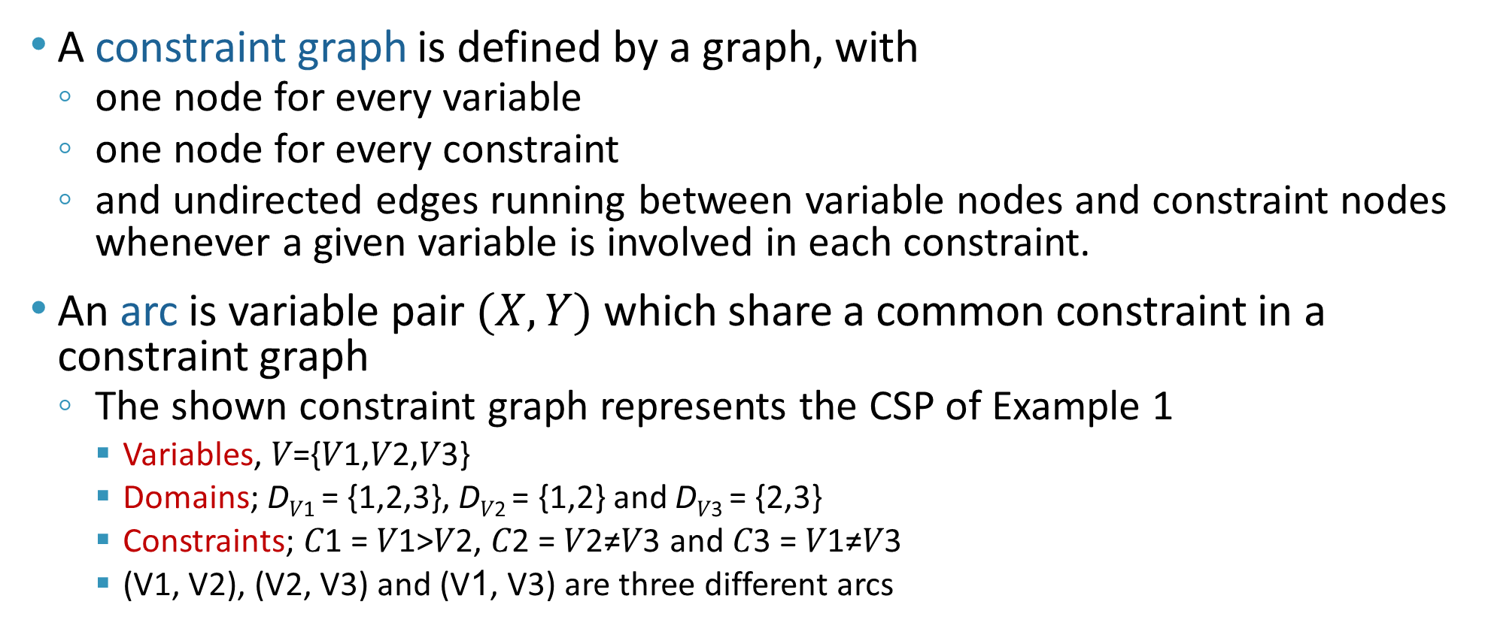
Constraint Graph
A constraint graph is defined by a graph, with
  one node for every variable
  one node for every constraint
  and undirected edges running between variable nodes and constraint nodes whenever a given variable is involved in each constraint.
An arc is variable pair $(X, Y)$ which share a common constraint in a constraint graph
  The shown constraint graph represents the CSP of Example 1
    Variables, 𝑉={𝑉1,𝑉2,𝑉3}
    Domains; D_{𝑉1} = {1,2,3}, D_{𝑉2} = {1,2} and D_{𝑉3} = {2,3}
    Constraints; 𝐶1 = 𝑉1>𝑉2, 𝐶2 = 𝑉2≠𝑉3 and 𝐶3 = 𝑉1≠𝑉3
    (V1, V2), (V2, V3) and (V1, V3) are three different arcs
V1
V1>V2
V1≠V3
V2
V2≠V3
V3

Slide 57
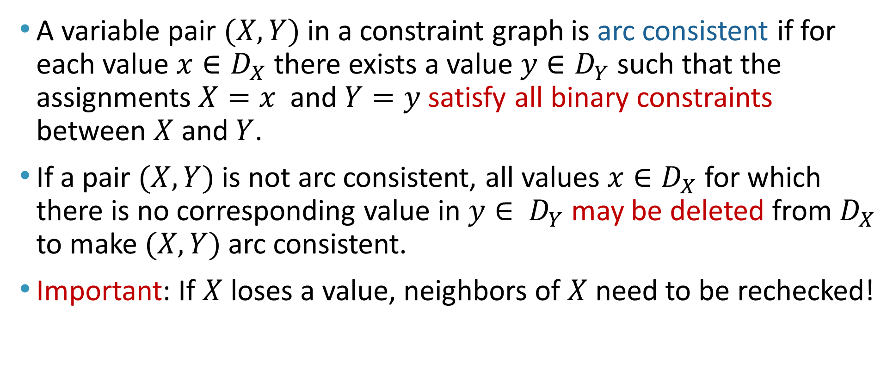
Consistency of a Single Arc
A variable pair $(X, Y)$in a constraint graph is arc consistent if for each value $x∈D_{X}$ there exists a value $y∈D_{Y}$ such that the assignments $X=x$ and $Y=y$satisfy all binary constraints between $X$ and $Y$.
If a pair $(X, Y)$is not arc consistent, all values $x∈D_{X}$ for which there is no corresponding value in $y∈ D_{Y}$may be deleted from $D_{X}$ to make $(X, Y)$arc consistent.
Important: If $X$ loses a value, neighbors of $X$ need to be rechecked!

Slide 58
Consistency of a Single Arc
Example:
    Variables, 𝑉={𝑉1,𝑉2,𝑉3}
    Domains; D_{𝑉1} = {1,2,3}, D_{𝑉2} = {1,2} and D_{𝑉3} = {2,3}
  (V1, V2) is not arc consistent because when V1 = 1, V2 will not have any valid assignment.
    How can we make (V1, V2) arc consistent?
      By removing 1 from D_{𝑉1}, i.e. becomes D_{𝑉1} = {2,3}
  What about (V1, V3) (V2, V3)? Are they arc consistent?
V1
V1>V2
V1≠V3
V2
V2≠V3
V3

Slide 59
Consistency of an Entire CSP
A CSP is arc consistent if all variable pairs are arc consistent.
Arc consistency is a very efficient mechanism for optimizing the search space of a CSP. It helps prune domains of variables to the minimum possible.
Arc consistency can detect failure earlier than forward checking
Three possible outcomes when CSP is made arc consistent :
  One of the domains is empty no solution
  Each domain has a single value unique solution
  Some domains have more than one value may or may not be a solution; we have to perform backtracking search!

Slide 60
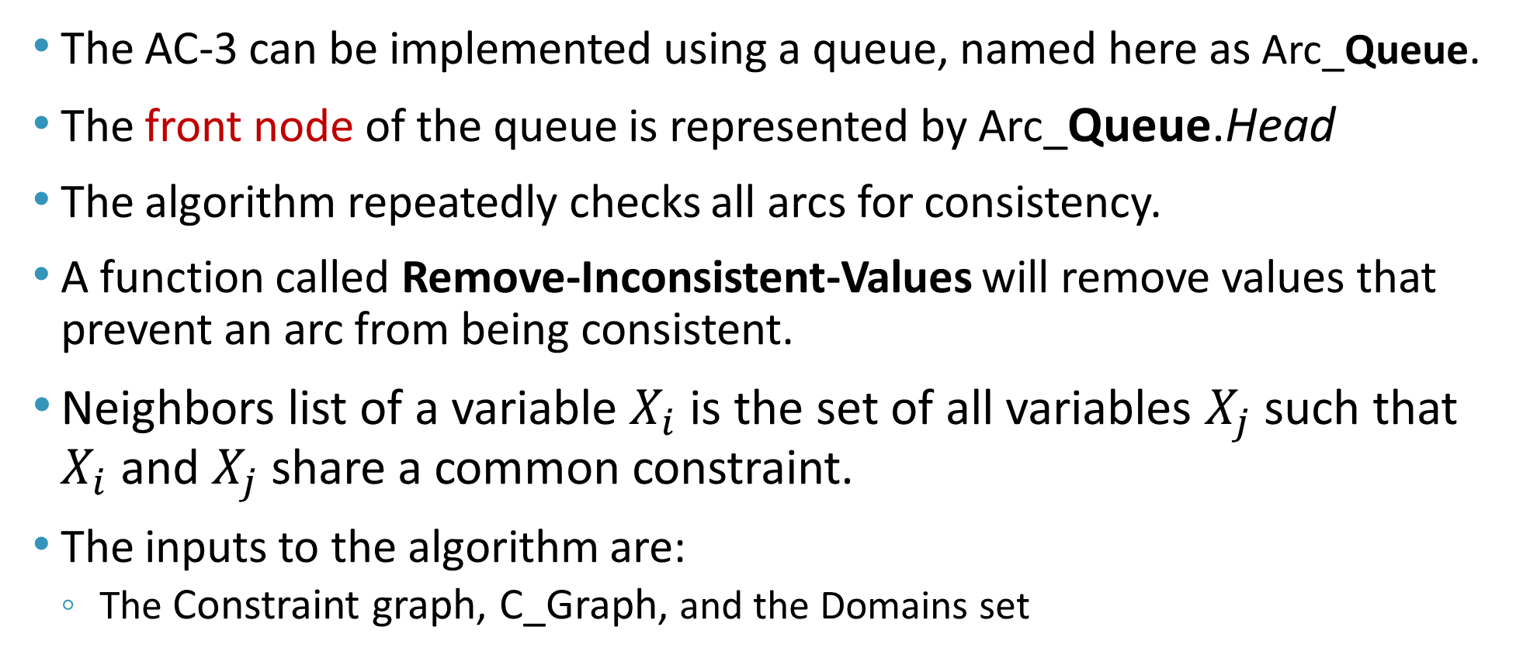
Arc Consistency – AC-3 Algorithm
The AC-3 can be implemented using a queue, named here as Arc_Queue.
The front node of the queue is represented by Arc_Queue.Head
The algorithm repeatedly checks all arcs for consistency.
A function called Remove-Inconsistent-Values will remove values that prevent an arc from being consistent.
Neighbors list of a variable $X_{i}$ is the set of all variables $X_{j}$ such that $X_{i}$ and $X_{j}$ share a common constraint.
The inputs to the algorithm are:
  The Constraint graph, C_Graph, and the Domains set

Slide 61
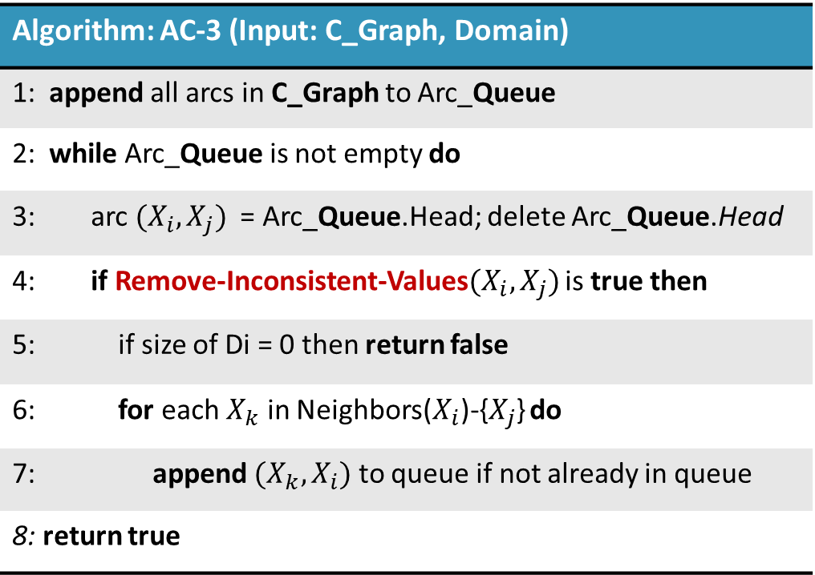
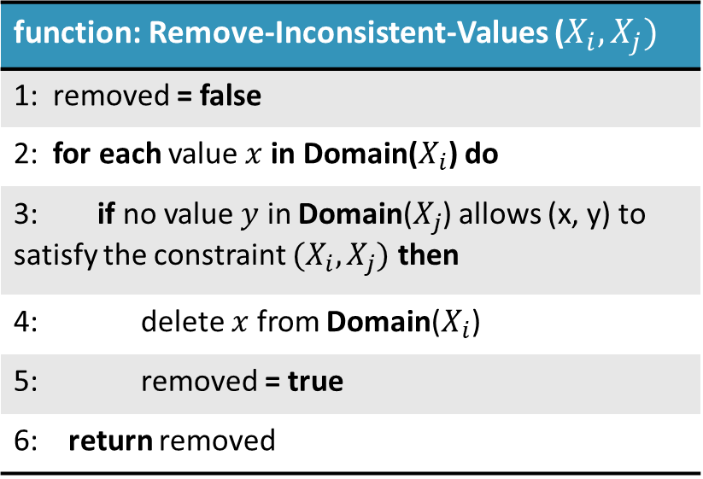
Arc Consistency – AC-3 algorithm
Algorithm: AC-3 (Input: C_Graph, Domain)
1: append all arcs in C_Graph to Arc_Queue
2: while Arc_Queue is not empty do
3: arc $(X_{i}, X_{j})$ = Arc_Queue.Head; delete Arc_Queue.Head
4: if Remove-Inconsistent-Values$(X_{i}, X_{j})$ is true then
5: if size of Di = 0 then return false
6: for each $X_{k}$ in Neighbors($X_{i}$)-{$X_{j}$} do
7: append $(X_{k}, X_{i})$ to queue if not already in queue
8: return true
function: Remove-Inconsistent-Values ($X_{i}, X_{j})$
1: removed = false
2: for each value $x$ in Domain($X_{i}$) do
3: if no value $y$ in Domain($X_{j}$) allows (x, y) to satisfy the constraint $(X_{i}, X_{j})$ then
4: delete $x$ from Domain($X_{i}$)
5: removed = true
6: return removed

Slide 62
AC-3 algorithm - Implementation
Example: Consider the shown constraint graph:
  Variables, 𝑉={X , Y, Z}
  Domains, D_{X} = D_{Y} = D_{Z} = {1,2,3,4,5,6}
  Constraints, 𝐶1 = X < Y, 𝐶2 = Z < X-2
  Neighbors list
    Neighbors(X) = {Y, Z}
    Neighbors(Y) = {X}
    Neighbors(Z) = {X}
X
X < Y
Z < x-2
Y
Z

Slide 63
AC-3 algorithm - Implementation
Step 1:
  Enqueue all arcs
  Arc_Queue = (X,Y), (Y,X), (X,Z), (Z,X)
  Domains: D_{X} = D_{Y} = D_{Z} = {1,2,3,4,5,6}
X
X < Y
Z < x-2
Y
Z

Slide 64
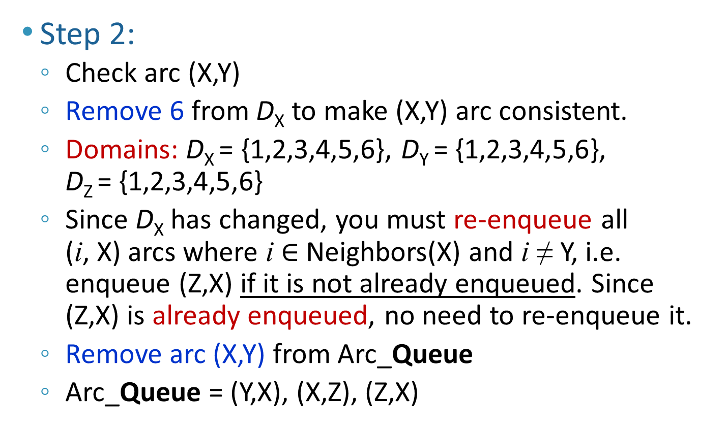
AC-3 algorithm - Implementation
Step 2:
  Check arc (X,Y)
  Remove 6 from D_{X} to make (X,Y) arc consistent.
  Domains: D_{X} = {1,2,3,4,5,6}, D_{Y} = {1,2,3,4,5,6}, D_{Z} = {1,2,3,4,5,6}
  Since D_{X} has changed, you must re-enqueue all (i, X) arcs where i $∈$Neighbors(X) and i ≠ Y, i.e. enqueue (Z,X) if it is not already enqueued. Since (Z,X) is already enqueued, no need to re-enqueue it.
  Remove arc (X,Y) from Arc_Queue
  Arc_Queue = (Y,X), (X,Z), (Z,X)
X
X < Y
Z < x-2
Y
Z

Slide 65
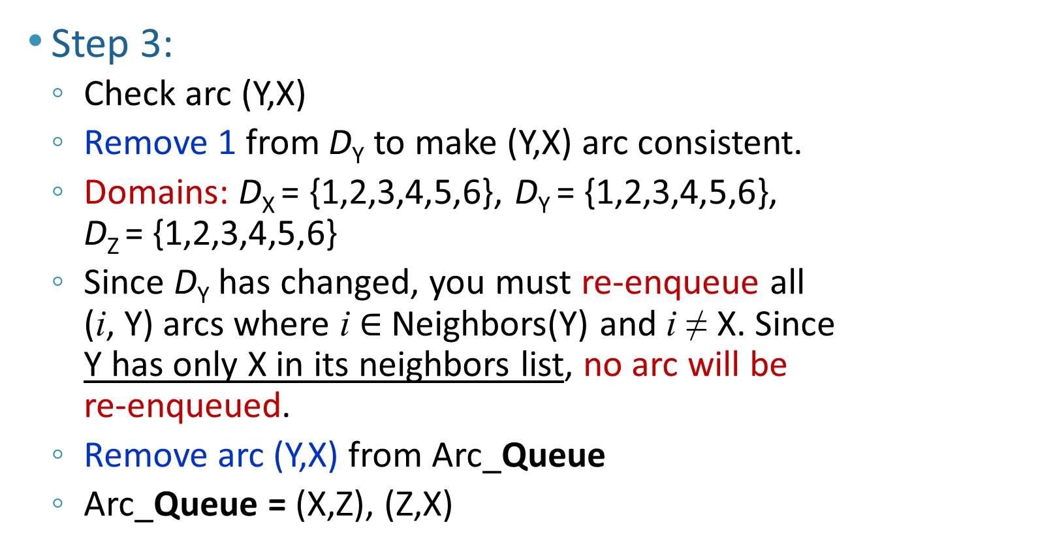
AC-3 algorithm - Implementation
Step 3:
  Check arc (Y,X)
  Remove 1 from D_{Y} to make (Y,X) arc consistent.
  Domains: D_{X} = {1,2,3,4,5,6}, D_{Y} = {1,2,3,4,5,6}, D_{Z} = {1,2,3,4,5,6}
  Since D_{Y} has changed, you must re-enqueue all (i, Y) arcs where i $∈$Neighbors(Y) and i ≠ X. Since Y has only X in its neighbors list, no arc will be re-enqueued.
  Remove arc (Y,X) from Arc_Queue
  Arc_Queue = (X,Z), (Z,X)
X
X < Y
Z < x-2
Y
Z

Slide 66
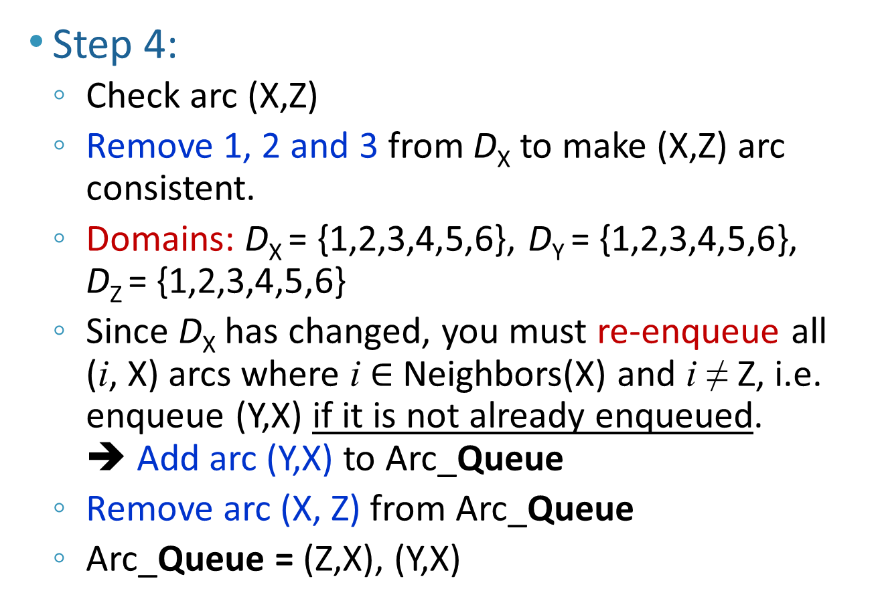
AC-3 algorithm - Implementation
Step 4:
  Check arc (X,Z)
  Remove 1, 2 and 3 from D_{X} to make (X,Z) arc consistent.
  Domains: D_{X} = {1,2,3,4,5,6}, D_{Y} = {1,2,3,4,5,6}, D_{Z} = {1,2,3,4,5,6}
  Since D_{X} has changed, you must re-enqueue all (i, X) arcs where i $∈$Neighbors(X) and i ≠ Z, i.e. enqueue (Y,X) if it is not already enqueued. ➔ Add arc (Y,X) to Arc_Queue
  Remove arc (X, Z) from Arc_Queue
  Arc_Queue = (Z,X), (Y,X)
X
X < Y
Z < x-2
Y
Z

Slide 67
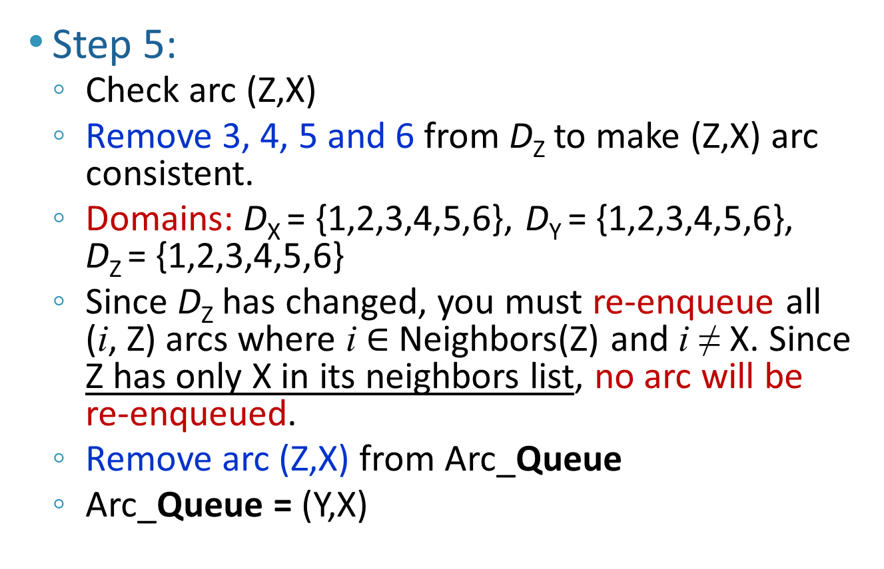
AC-3 algorithm - Implementation
Step 5:
  Check arc (Z,X)
  Remove 3, 4, 5 and 6 from D_{Z} to make (Z,X) arc consistent.
  Domains: D_{X} = {1,2,3,4,5,6}, D_{Y} = {1,2,3,4,5,6}, D_{Z} = {1,2,3,4,5,6}
  Since D_{Z} has changed, you must re-enqueue all (i, Z) arcs where i $∈$Neighbors(Z) and i ≠ X. Since Z has only X in its neighbors list, no arc will be re-enqueued.
  Remove arc (Z,X) from Arc_Queue
  Arc_Queue = (Y,X)
X
X < Y
Z < x-2
Y
Z

Slide 68
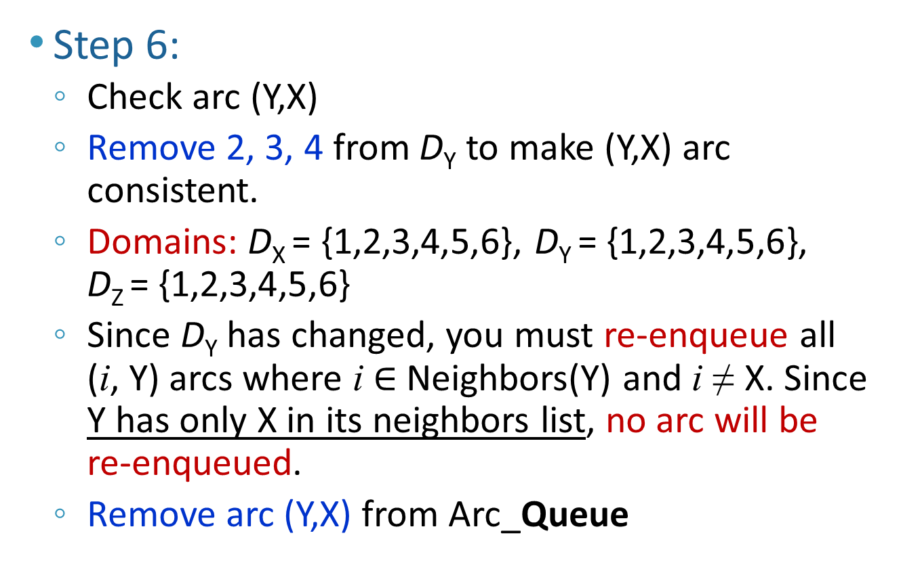
AC-3 algorithm - Implementation
Step 6:
  Check arc (Y,X)
  Remove 2, 3, 4 from D_{Y} to make (Y,X) arc consistent.
  Domains: D_{X} = {1,2,3,4,5,6}, D_{Y} = {1,2,3,4,5,6}, D_{Z} = {1,2,3,4,5,6}
  Since D_{Y} has changed, you must re-enqueue all (i, Y) arcs where i $∈$Neighbors(Y) and i ≠ X. Since Y has only X in its neighbors list, no arc will be re-enqueued.
  Remove arc (Y,X) from Arc_Queue
X
X < Y
Z < x-2
Y
Z

Slide 69
AC-3 algorithm - Implementation
Step 7:
  Arc_Queue is empty
  The CSP is now arc consistent
  Domains: D_{X} = {4,5}, D_{Y} = {5,6}, D_{Z} = {1,2}
Remarks
  Reduced domains have more than one value
  There may or may not be a solution
  Backtracking search is needed to check if there is a solution
  There could be more than one solution
X
X < Y
Z < x-2
Y
Z

Slide 70
AC-3 algorithm - Implementation - Summary
# | Arc_Queue | Constraint | Updated Domains | Action
1. |  |  | D_{X} = D_{Y} = D_{Z} = {1,2,3,4,5,6} | Start with an empty Arc_Queue. Enqueue all 4 arcs.
2. | [(X,Y), (Y,X), (X,Z), (Z,X)] | X < Y | D_{X} = {1,2,3,4,5}, D_{Y} = {1,2,3,4,5,6} D_{Z} = {1,2,3,4,5,6} | Check (X,Y). Remove 6 from D_{X} to make (X,Y) arc consistent. Since D_{X} has changed, you must re-enqueue (Z,X) if it is not already enqueued. But it is already enqueued. Remove (X,Y) from Arc_Queue.
3. | [(Y,X), (X,Z), (Z,X)] | Y > X | D_{X} = {1,2,3,4,5}, D_{Y} = {2,3,4,5,6} D_{Z} = {1,2,3,4,5,6} | Check (Y,X). Remove 1 from D_{y} to make (Y,X) arc consistent. Since Y has only X in its neighbors list. No arc need to be re-enqueued. Remove (Y,X) from Arc_Queue.

Slide 71
AC-3 algorithm - Implementation - Summary
# | Arc_Queue | Constraint | Updated Domains | Action
4. | [(X,Z), (Z,X)] | X > Z+2 | D_{X} = {4,5}, D_{Y} = {2,3,4,5,6} D_{Z} = {1,2,3,4,5,6} | Check (X,Z). Remove 1, 2 and 3 from D_{X} to make (X,Z) arc consistent. Since D_{X} changed, you must enqueue (Y,X) if it is not already enqueued. Remove (X,Z) from Arc_Queue. Add (Y,X) to queue.
5. | [(Z,X), (Y,X)] | Z < X-2 | D_{X} = {4,5}, D_{Y} = {2,3,4,5,6} D_{Z} = {1,2} | Check (Z,X). Remove 3, 4, 5 and 6 from D_{Z} to make (Z,X) arc consistent. Since Z has only X in the neighbors list. No arc need to be re-enqueued. Remove (Z,X) from Arc_Queue.

Slide 72
AC-3 algorithm - Implementation - Summary
# | Arc_Queue | Constraint | Updated Domains | Action
6. | [(Y,X)] | Y > X | D_{X} = {4,5}, D_{Y} = {5,6} and D_{Z} = {1,2} | Check (Y,X). Remove 2, 3, 4 from D_{y} to make (Y,X) arc consistent. Since Y has only X in the neighbors list. No arc need to be re-enqueued. Remove (Y,X) from Arc_Queue.
7. | [] |  |  | Arc_Queue is empty. The CSP is now arc consistent

Slide 73
CSP Example 3: Scheduling
KFUPM decides to open a company called Fly-KFUPM. A study concluded that Fly-KFUPM must have the shown flights per day
There is about 30 min cleaning time and boarding time for each flight
Fly-KFUPM has its base in Dammam and Riyadh (Airplane can be parked and stay overnight in a base only).
No. | From | To | Time of Departure | Duration in hours
F1 | Dammam | Riyadh | 08:00 | 1
F2 | Riyadh | Dammam | 09:30 | 1
F3 | Dammam | Riyadh | 11:00 | 1
F4 | Riyadh | Dammam | 12:00 | 1
F5 | Dammam | Rome | 8:00 | 6

Slide 74
CSP Example 3: Scheduling
The business school is preparing a feasibility study but needs to know how many planes will be required to conduct all flights mentioned above.
You are working over the summer for KFUPM, and you are given the task to determine the minimum number of planes required so that the schedule is met.
How many planes will you recommend?

Slide 75
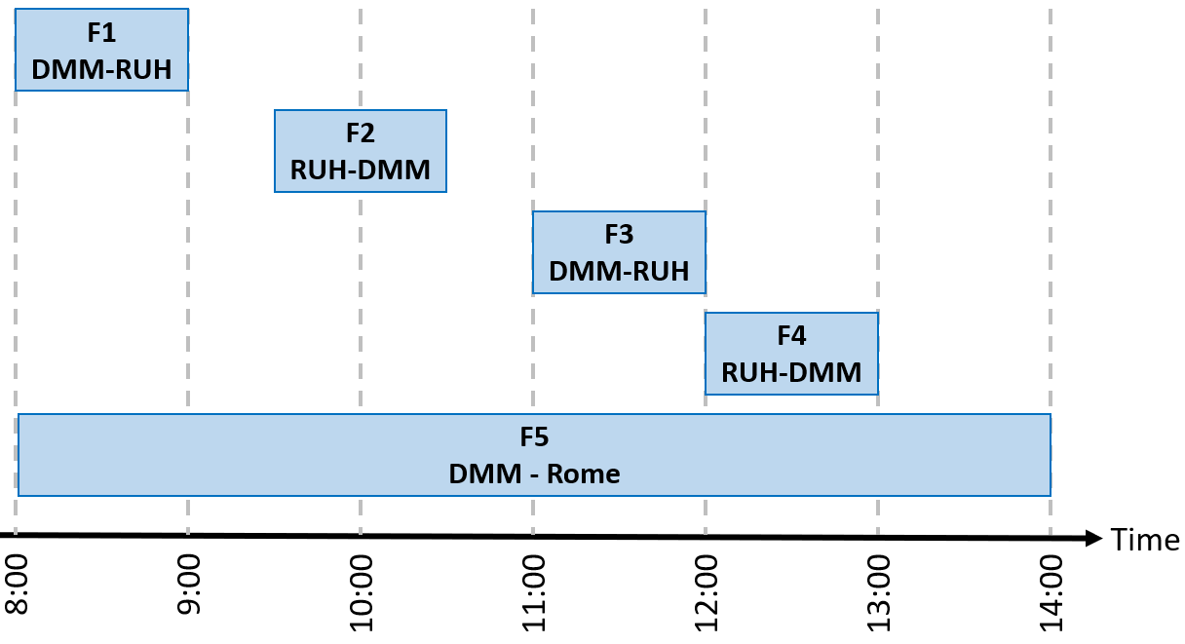
CSP Example 3: Scheduling
The key to solving this problem is:
  Get the right representation
  Select an appropriate model to solve the problem
  Implement the model
What is the best representation?
  The best representation is one that captures all the data in the question and presents it in a way that is easy to perceive.

Slide 76
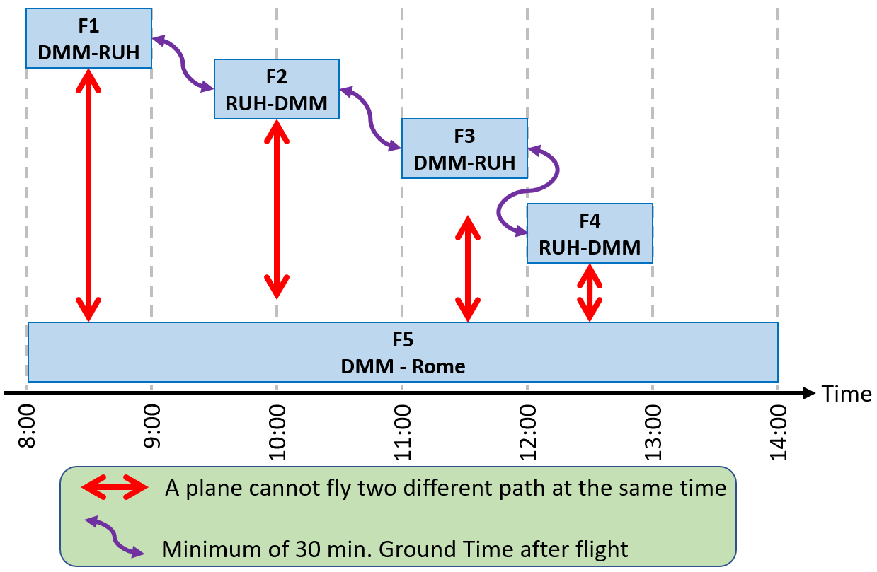
CSP Example 3: Scheduling – Representation
Add the constraints:
  Minimum of 30 min Ground Time after flight
  A plane cannot fly two different paths at the same time
  A plane can start from either Dammam or Riyadh since Fly-KFUPM has a base there
Implementation constraint
  A plane that lands in a city cannot take off from another city unless it flies to that city

Slide 77
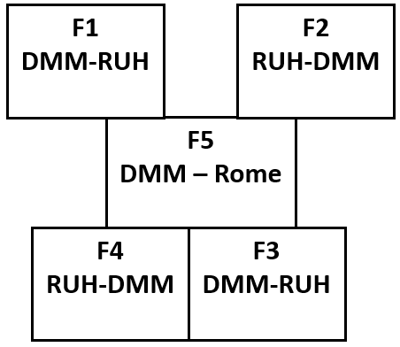
CSP Examples 3: Scheduling – Select a Model
Model = Map Coloring
Shift the representation to map coloring such that it satisfies all the constraints

Slide 78
CSP Example 3: Scheduling – Implement
To determine the minimum numbers of planes required, lets bound the number the absolute minimum and absolute maximum
  The absolute minimum number of planes is 1
  The absolute maximum number of planes is 5 (since there are 5 different paths and each one can be assigned to one)
To find the number of planes using the map coloring problem use the generate and test (lecture 1), i.e., test starting from 1 plane and keep increasing the number by 1 until you get a success.
  Obviously 1 Plane will not work.

Slide 79
CSP Example 3: Scheduling – Implement 2 planes
2 Planes with sequential assignment of planes where P1 is the first plane and P2 is the second one.
  Variables:
    V={V1 = F1, V2 = F2, V3 = F3, V4 = F4, V5 = F5}
  Domain of each variable is {P1, P2}
  Constraints:
    Minimum of 30 min Ground Time after flight
    A plane cannot fly two different paths at the same time
    A plane can start from either Dammam or Riyadh since Fly-KFUPM has a base there
    A plane that lands in a city cannot take off from another city unless it flies to that city

Slide 80
CSP Example 3: Scheduling – Implement 2 planes
  CSP Using backtracking algorithm

Slide 81
CSP Example 3: Scheduling – Implement 2 planes
  Planes are not enough → increase the number of planes to 3 Domain {P1, P2, P3}

Slide 82
CSP Example 3: Scheduling – Implement 3 planes
  CSP Using backtracking algorithm:

Slide 83
CSP Example 3: Scheduling – Implement 3 planes

Slide 84
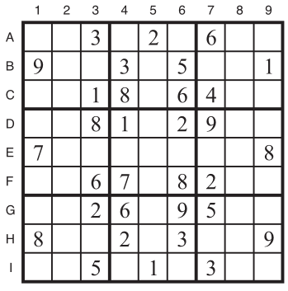
CSP Example 4: Sudoku Puzzle
The Sudoku problem objective is to fill a 9 x 9 grid with numerical digits so that each column, each row and each of the nine 3 x 3 sub-grids (also called boxes) contains one of all the digits 1 through 9.
A typical Sudoku puzzle is shown:

Slide 85
CSP Example 4: Sudoku Puzzle - Model
It has 81 variables: {A1, A2, ..., A9, I1, I2 , ..., I9}
Empty squares domain : {1, 2, 3, 4, 5, 6, 7, 8, 9}
27 All different (Alldiff) constraints:
  Rows:
    Alldiff (A1, A2, A3, A4, A5, A6, A7, A8, A9)
    Alldiff (B1, B2, B3, B4, B5, B6, B7, B8, B9)
    ···
  Columns:
    Alldiﬀ (A1, B1, C1, D1, E1, F1, G1, H1, I1)
    Alldiﬀ (A2, B2, C2, D2, E2, F2, G2, H2, I2)
    ···
  3x3 sub-grids
    Alldiﬀ (A1, A2, A3, B1, B2, B3, C1, C2, C3)
    Alldiﬀ (A4, A5, A6, B4, B5, B6, C4, C5, C6)

Slide 86
CSP Example 4: Sudoku Puzzle - Model
We can solve the problem by using generate-and-test method, but it will take 9^{n}, where n is the number of unfilled boxes
  In this example, it is 9⁴⁹=5.7x10⁴⁶
Using constraint satisfaction problem, we can reduce the time.

Slide 87
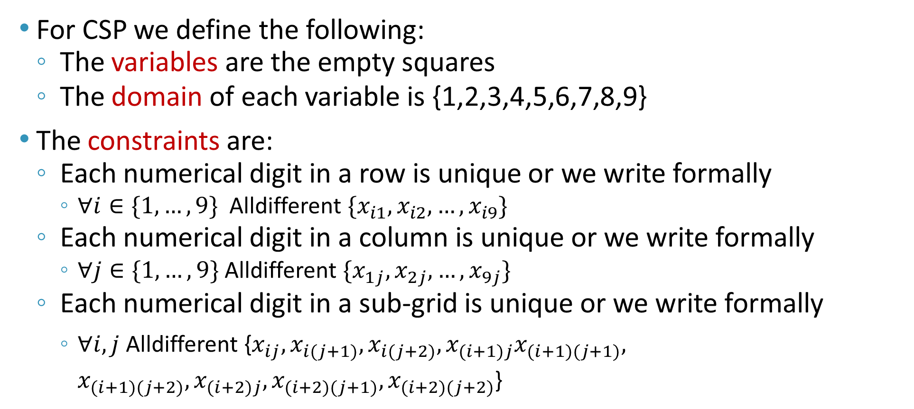
CSP Example 4: Sudoku Puzzle - Model
For CSP we define the following:
  The variables are the empty squares
  The domain of each variable is {1,2,3,4,5,6,7,8,9}
The constraints are:
  Each numerical digit in a row is unique or we write formally
    $∀i∈\{1,…,9\}$Alldifferent $\{x_{i1},x_{i2},…,x_{i9}\}$
  Each numerical digit in a column is unique or we write formally
    $∀j∈\{1,…,9\}$ Alldifferent $\{x_{1j},x_{2j},…,x_{9j}\}$
  Each numerical digit in a sub-grid is unique or we write formally
    $∀i,j$ Alldifferent {$x_{ij},x_{i(j+1)},x_{i(j+2)},x_{(i+1)j}x_{(i+1)(j+1)}, x_{(i+1)(j+2)},x_{(i+2)j},x_{(i+2)(j+1)},x_{(i+2)(j+2)}$}

Slide 88
CSP Example 4: Sudoku Puzzle - Model
We can define the domain of 𝐴1={1,2,3,4,5,6,7,8,9} and apply the following constraints:
  Row constraint 𝐴1≠{3,2,6}
  Column constraint 𝐴1≠{9,7,8}
  Sub-grid constraint 𝐴1≠{3,9,1}
This reduces the domain of A1 to {4,5}
We keep doing this for the remaining cells and then solve the CSP problem using backtracking.

Slide 89
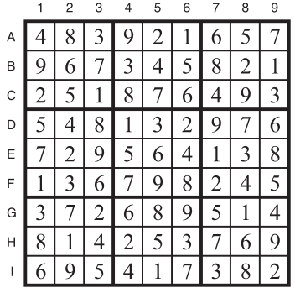
CSP Example 4: Sudoku Puzzle – Implementation
The solution is then:
Solved by AC-3 alone

Slide 90
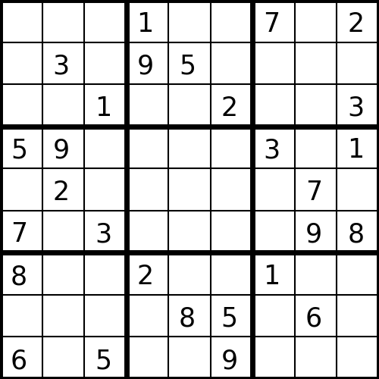
CSP: Sudoku Puzzle – Backtracking Example
After running AC-3, no variable was assigned
https://sandipanweb.wordpress.com/2017/03/17/solving-sudoku-as-a-constraint-satisfaction-problem-using-constraint-propagation-with-arc-consistency-checking-and-then-backtracking-with-minimum-remaning-value-heuristic-and-forward-checking/

Slide 91
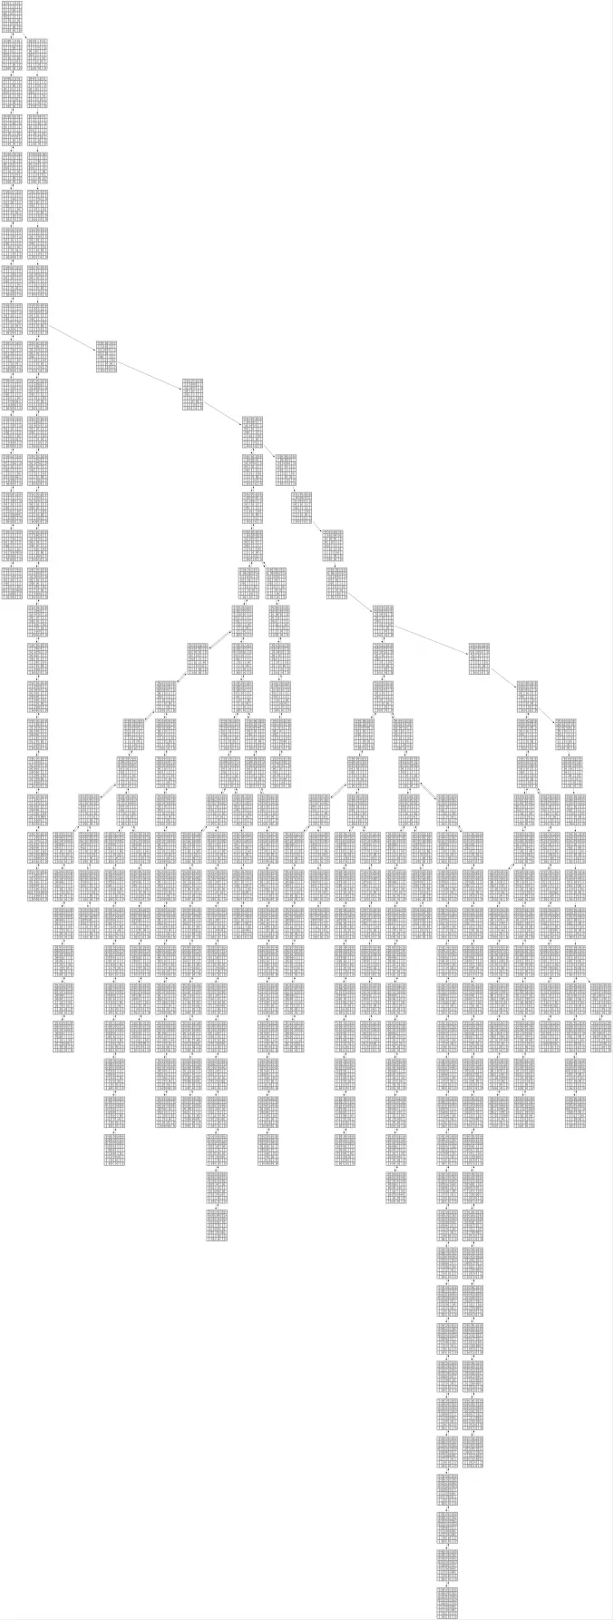
CSP: Sudoku – Tree
A typical tree constructed by a computer is shown below:
Search Tree Root

Slide 92
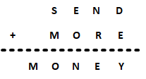
CSP: Cryptarithmetic
Given the shown expression, Find the value of each letter given the following:
  Each letter should have a unique and distinct value.
  Each letter represents only one-digit throughout the problem.
  Numbers must not begin with zero i.e., 0937 (wrong), 937 (correct).
  There must be only one solution to the problem.
  After replacing letters by their digits, the resulting arithmetic operations must be correct.

Slide 93
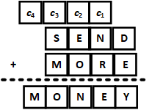
CSP: Cryptarithmetic
Start by understanding addition and identify
  Variables V= {S, E, N, D, M, O, R, Y, c₁, c₂, c₃, c₄}
  The domains:
    𝑆={0,1,2,3,4,5,6,7,8,9}; domain of variable S
    S = E = N = D = M = O = R = Y
    c₁ = {0,1}; domain of variable c₁
    c₁ = c₂ = c₃ = c₄
Note: We need to introduce the carry to enable solving the problem.

Slide 94
CSP: Cryptarithmetic
Constraints:
  Each letter should have a unique and distinct value.
  Each letter represents only one-digit throughout the problem.
  Numbers must not begin with zero, i.e., 0937 (wrong), 937 (correct).
  There must be only one solution to the problem.
  After replacing letters by their digits, the resulting arithmetic operations must be correct.

Slide 95
CSP: Cryptarithmetic
Step 1: Using constraint (3), i.e. numbers must not begin with zero, we can say that the domain of 𝑆, 𝑀 is reduced to {1,2,3,4,5,6,7,8,9}
Step 2: Since 𝑀=𝑐₄ , 𝑐₄ cannot be 0 because this will make 𝑀=0. Therefore, 𝑐₄=1 and 𝑀=1 and the problem reduces to
1
1
1
    𝑆={2,3,4,5,6,7,8,9}
    E={0,2,3,4,5,6,7,8,9}
    N={0,2,3,4,5,6,7,8,9}
    D={0,2,3,4,5,6,7,8,9}
    M={1}
    O={0,2,3,4,5,6,7,8,9}
    R={0,2,3,4,5,6,7,8,9}
    Y={0,2,3,4,5,6,7,8,9}
Updated domains of variables

Slide 96
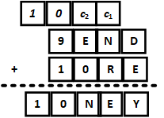
CSP: Cryptarithmetic
Step 3: consider 𝑐₃+𝑆+1=10+𝑂 (Note that the 10 is due to 𝑐4=1). From this equation, the domain of 𝑆 is reduced to {8,9}. Therefore, all possible cases for c₃, S, O are:
  if 𝑐3=0 and 𝑆=9 then 𝑂=0
  if 𝑐3=1 and 𝑆=8 then 𝑂=0
  if 𝑐3=1 and 𝑆=9 then 𝑂=1,
  A contradiction is observed with constraint (1) where 𝑀=𝑂=1 ⇒ discard this option.
  We will select 𝑐3=0, 𝑆=9 and 𝑂=0 and the problem reduces to:
1
0
1
9
1
1
0
1
1
0
    𝑆={9}
    E={2,3,4,5,6,7,8}
    N={2,3,4,5,6,7,8}
    D={2,3,4,5,6,7,8}
    M={1}
    O={0}
    R={2,3,4,5,6,7,8}
    Y={2,3,4,5,6,7,8}
Updated domains of variables

Slide 97
CSP: Cryptarithmetic
Step 4: consider the equation 𝑐2+𝐸=𝑁. It has two possible solutions:
  if 𝑐₂=0 then we have 𝐸=𝑁, this contradicts with constraint (1), i.e. Each letter should have a unique and distinct value → discard this option.
  𝑐₂=1 then we have 1+𝐸=𝑁
0
1
1
0
1
1
9
9
1
1
1
0
1
1
1
0
0
    𝑆={9}
    E={2,3,4,5,6,7,8}
    N={2,3,4,5,6,7,8}
    D={2,3,4,5,6,7,8}
    M={1}
    O={0}
    R={2,3,4,5,6,7,8}
    Y={2,3,4,5,6,7,8}
Updated domains of variables

Slide 98
CSP: Cryptarithmetic
Step 5: Consider 𝑐₁+𝑁+𝑅=10+𝐸. Using Step 4, (1+𝐸=𝑁), then substituting above we get 𝑐1+𝑅=9.
  Selecting 𝑐₁=0 will result with 𝑅=9, contradicts with constraint (1) since we have already chosen 𝑆=9, discard the option.
  Thus, selecting 𝑐₁=1 will result with 𝑅=8 and the problem reduces to:
1
0
1
1
0
1
0
1
1
1
9
9
9
1
1
1
1
0
8
1
1
1
1
0
0
0
    𝑆={9}
    E={2,3,4,5,6,7}
    N={2,3,4,5,6,7}
    D={2,3,4,5,6,7}
    M={1}
    O={0}
    R={8}
    Y={2,3,4,5,6,7}
Updated domains of variables

Slide 99
CSP: Cryptarithmetic
Step 6: Consider the equation 𝐷+𝐸=10+𝑌, since the numbers 0,1,8 and 9 are taken, we need two numbers that generate a sum greater than 9. The remaining options are:
  𝐷=3 and 𝐸=7 that makes 𝐷+𝐸=10 and 𝑌=0, but since 𝑂=0 has already been selected, discard this option
  𝐷=4 and 𝐸=7 that makes 𝐷+𝐸= 11 and 𝑌=1, but since 𝑀=1 has already been selected, discard this option
  𝐷=5 and 𝐸=7 that makes 𝑌=2
1
1
0
1
1
0
1
0
1
1
1
9
7
9
9
5
1
8
1
1
1
0
8
7
1
1
1
1
0
0
0
7
2
    𝑆={9}
    E={7}
    N={3,4,6}
    D={5}
    M={1}
    O={0}
    R={8}
    Y={2}
Updated domains of variables

Slide 100
CSP: Cryptarithmetic
Step 7: Going back to Step 4, (1+𝐸=𝑁), and substituting 𝐸=7 makes 𝑁=8, this contradicts with constraint (1)→ backtrack
Select 𝐸=5 that makes
  𝑁= 1+𝐸=6,
  𝐷= 7
  𝑌=2 (no change)
The final solution then becomes:
1
1
1
1
1
0
1
0
0
1
0
1
1
1
1
9
6
9
5
7
1
8
5
1
1
1
1
0
8
8
1
2
1
1
1
1
0
0
0
0
6
5
2
    𝑆={9}
    E={5}
    N={6}
    D={7}
    M={1}
    O={0}
    R={8}
    Y={2}
Updated domains of variables

Slide 101
Cryptarithmetic Puzzles Program
Summary of the problem: A cryptarithmetic puzzle is a mathematical exercise where the digits of some numbers are represented by letters (or symbols). Each letter represents a unique digit. The goal is to find the digits such that a given mathematical equation is verified.
Example:
CP
+ IS
+ FUN
--------
= TRUE

Slide 102
Cryptarithmetic Puzzles Program
One assignment (Solution) of letters to digits yields the following equation:
There are other answers to this problem. We'll show how to find all solutions next.
CP
+ IS
+ FUN
--------
= TRUE
23
+ 74
+ 968
--------
= 1065

Slide 103
Cryptarithmetic Puzzles Library
To run the code we will be discussing, you need to install a library to run the code given below. To install, open the command prompt and type the following:
  python -m pip install --upgrade --user ortools
  Press Enter and wait until it finishes
  OR (from a notebook) !pip install ortools
Note: you may need to load the notebook again for the tool to work or run the server again depending on your machine.

Slide 104
Cryptarithmetic Puzzles Modeling
As with any CSP, we start by identifying variables and constraints.
  The variables are the letters, which can take on any single digit value
    V={C, P, I, S, F, U, N, T, R, E}
  Note that there will be no repeating variable. Also, the values of the variables are single digits, therefore the domain is 0 to 9.
Follow the steps to program your machine to solve the cryptarithmetic problems.

Slide 105
Cryptarithmetic Puzzles Code
Step 1: Import the required libraries.
Step 2: Set up the variables
base = 10
c = model.NewIntVar(1, 9, 'C')
p = model.NewIntVar(0, 9, 'P')
i = model.NewIntVar(1, 9, 'I')
s = model.NewIntVar(0, 9, 'S')
f = model.NewIntVar(1, 9, 'F')
u = model.NewIntVar(0, 9, 'U')
n = model.NewIntVar(0, 9, 'N')
t = model.NewIntVar(1, 9, 'T')
r = model.NewIntVar(0, 9, 'R')
e = model.NewIntVar(0, 9, 'E')
# We need to group variables in a list to use the constraint AllDifferent.
letters = [c, p, i, s, f, u, n, t, r, e]
# Verify that we have enough digits.
assert base >= len(letters)
from ortools.sat.python import cp_model
model = cp_model.CpModel()

Slide 106
Cryptarithmetic Puzzles Code
Step 3: Identify the constraints
  The variables are letters and can take on a single digit value
  Therefore, we can establish the following constraints
  CP + IS + FUN = TRUE
  Each of the letters must be a different digit
  C, I, F, T ≠ 0 (since leading digit in a number is not zero)
  The code below defines the constraints and the objective function
# Define the constraints
model.AddAllDifferent(letters)
# CP + IS + FUN = TRUE
model.Add(c * 10 + p + i * 10 + s + f * 10**2 + u * 10 + n == t * 10**3 + r * 10**2 + u * 10 + e)

Slide 107
Cryptarithmetic Puzzles Code
Step 4:Printing all Solutions
  We want the solver to print solutions as it finds them. The code below does that:
# Solution Printer Class
class VarArraySolutionPrinter(cp_model.CpSolverSolutionCallback):
def __init__(self, variables):
cp_model.CpSolverSolutionCallback.__init__(self)
self.__variables = variables
self.__solution_count = 0
def on_solution_callback(self):
self.__solution_count += 1
for v in self.__variables:
print('%s=%i ' %(v, self.Value(v)), end='')
print()
def solution_count(self):
return self.__solution_count

Slide 108
Cryptarithmetic Puzzles Code
Step 5: Invoke the Solver and call the printer.
Sample Run
# Call the solver
solver = cp_model.CpSolver()
solution_printer = VarArraySolutionPrinter(letters)
status = solver.SearchForAllSolutions(model, solution_printer)
C=6 P=4 I=3 S=5 F=9 U=2 N=8 T=1 R=0 E=7
C=3 P=4 I=6 S=5 F=9 U=2 N=8 T=1 R=0 E=7
C=3 P=4 I=6 S=8 F=9 U=2 N=5 T=1 R=0 E=7
C=3 P=2 I=6 S=7 F=9 U=8 N=5 T=1 R=0 E=4
C=3 P=2 I=6 S=5 F=9 U=8 N=7 T=1 R=0 E=4
C=2 P=3 I=7 S=6 F=9 U=8 N=5 T=1 R=0 E=4
C=2 P=3 I=7 S=4 F=9 U=6 N=8 T=1 R=0 E=5
C=2 P=3 I=7 S=5 F=9 U=4 N=8 T=1 R=0 E=6
C=2 P=3 I=7 S=8 F=9 U=4 N=5 T=1 R=0 E=6
C=2 P=3 I=7 S=8 F=9 U=6 N=4 T=1 R=0 E=5
C=2 P=3 I=7 S=5 F=9 U=8 N=6 T=1 R=0 E=4
C=7 P=3 I=2 S=5 F=9 U=8 N=6 T=1 R=0 E=4

Slide 109
Cryptarithmetic Puzzles Code
Step 6: Analyze Data:
Result
print()
print('Statistics')
print(' - status : %s' % solver.StatusName(status))
print(' - conflicts : %i' % solver.NumConflicts())
print(' - branches : %i' % solver.NumBranches())
print(' - wall time : %f s' % solver.WallTime())
print(' - solutions found : %i' % solution_printer.solution_count())
Statistics
- status : OPTIMAL
- conflicts : 179
- branches : 828
- wall time : 0.071651 s
- solutions found : 72

Slide 110
Conclusion
Constraint Satisfaction Problems consist of variables, associated with finite domains, and constraints which are binary relations specifying permissible value pairs.
In CSP, the objective is finding a solution for a problem where you need to satisfy some constraints. This has numerous real life applications including, e.g., scheduling and timetabling.
Backtracking search assigns values to variables one-by-one, and backtracks when there is an inconsistent assignment.
Improvements such as forward checking, MRV and arc consistency reduce the size of the CSP search space.

